Slide 1
Modelling the star-forming Main Sequence

Slide 2
Outline
The Star-forming Main Sequence
The Data
SED modelling
Main Sequence modelling
Results
Conclusion
SFMS
DATA
SEDs
MS
RESULTS
CONCLUSION

Slide 3
SFMS
DATA
SEDs
MS
RESULTS
CONCLUSION
Notes:
MS is SFR vs stellar mass
How are M and SFR measured?
What about covarying errors on M and SFR?
Which objects are definitely on the MS?

Slide 4
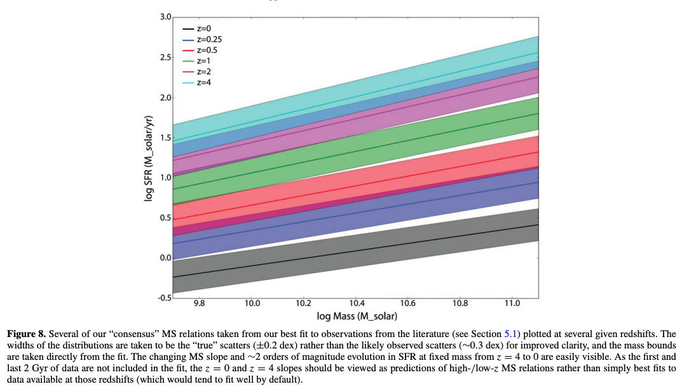
Speagle et al. 2014
SFMS
DATA
SEDs
MS
RESULTS
CONCLUSION
Notes:
Speagle 2014 review 25 studies
Normalisation increasing with redshift
Slope maybe increasing with redshift
~constant scatter 0.3 dex measured, ~0.2 dex intrinsic

Slide 5
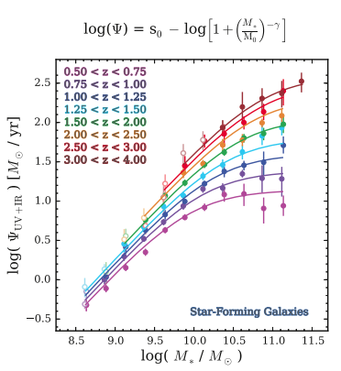
Tomczak et al. 2016
SFMS
DATA
SEDs
MS
RESULTS
CONCLUSION
Notes:
Tomczak 2016
Photo z and M from SED
SFR from UV + IR
Turnover at high mass
Real? Or due to SF selection at higher mass?

Slide 6
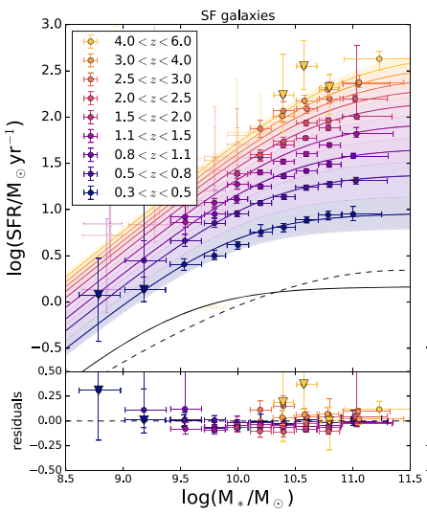
Leslie et al. 2020
SFMS
DATA
SEDs
MS
RESULTS
CONCLUSION
Notes:
Leslie 2020
Out to higher redshift

Slide 7
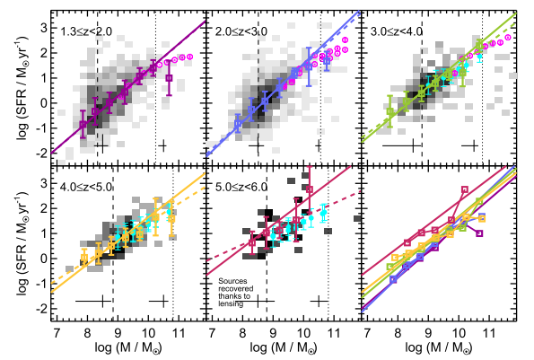
Santini et al. 2017
SFMS
DATA
SEDs
MS
RESULTS
CONCLUSION
Notes:
Santini 2017
Pushing to lower masses and higher redshift

Slide 8
So what’s the problem?
Various ways to measure Mass and SFR
emission lines, UV continuum, UV+IR, SED fitting etc
Lack of consistency with error propagation onto MS
intrinsic scatter
Inconsistent star-forming selection
rest frame colour-colour selection, fixed lines in MS plane, lower limits on observed emission line luminosities or EWs, sigma clipping on MS, Lyman break or LIRG selection, or no selection at all
SFMS
DATA
SEDs
MS
RESULTS
CONCLUSION

Slide 9
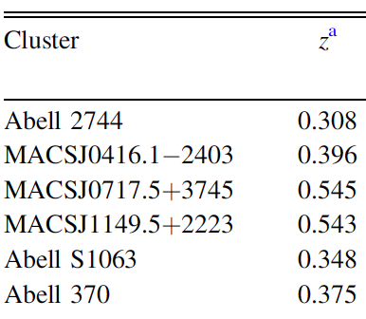
Hubble Frontier Fields
SFMS
DATA
SEDs
MS
RESULTS
CONCLUSION
Notes:
Lotz et al. 2017
6 clusters imaged with Hubble and Spitzer, alongside 6 parallel fields
840 HST orbits
Parallel fields AB mag 29 - 5 sigma point source depths
Hubble exposure times set so that intrinsic depths are 10x fainter than HUDF in highest magnification regions
Magnification can vary between 10 and 100x
Intrinsic depths of between 30 and 33 mag
1000hr spitzer
AB mag 26 – 5 sigma point source depth

Slide 10
SFMS
DATA
SEDs
MS
RESULTS
CONCLUSION
Notes:
Allows LOW masses

Slide 11
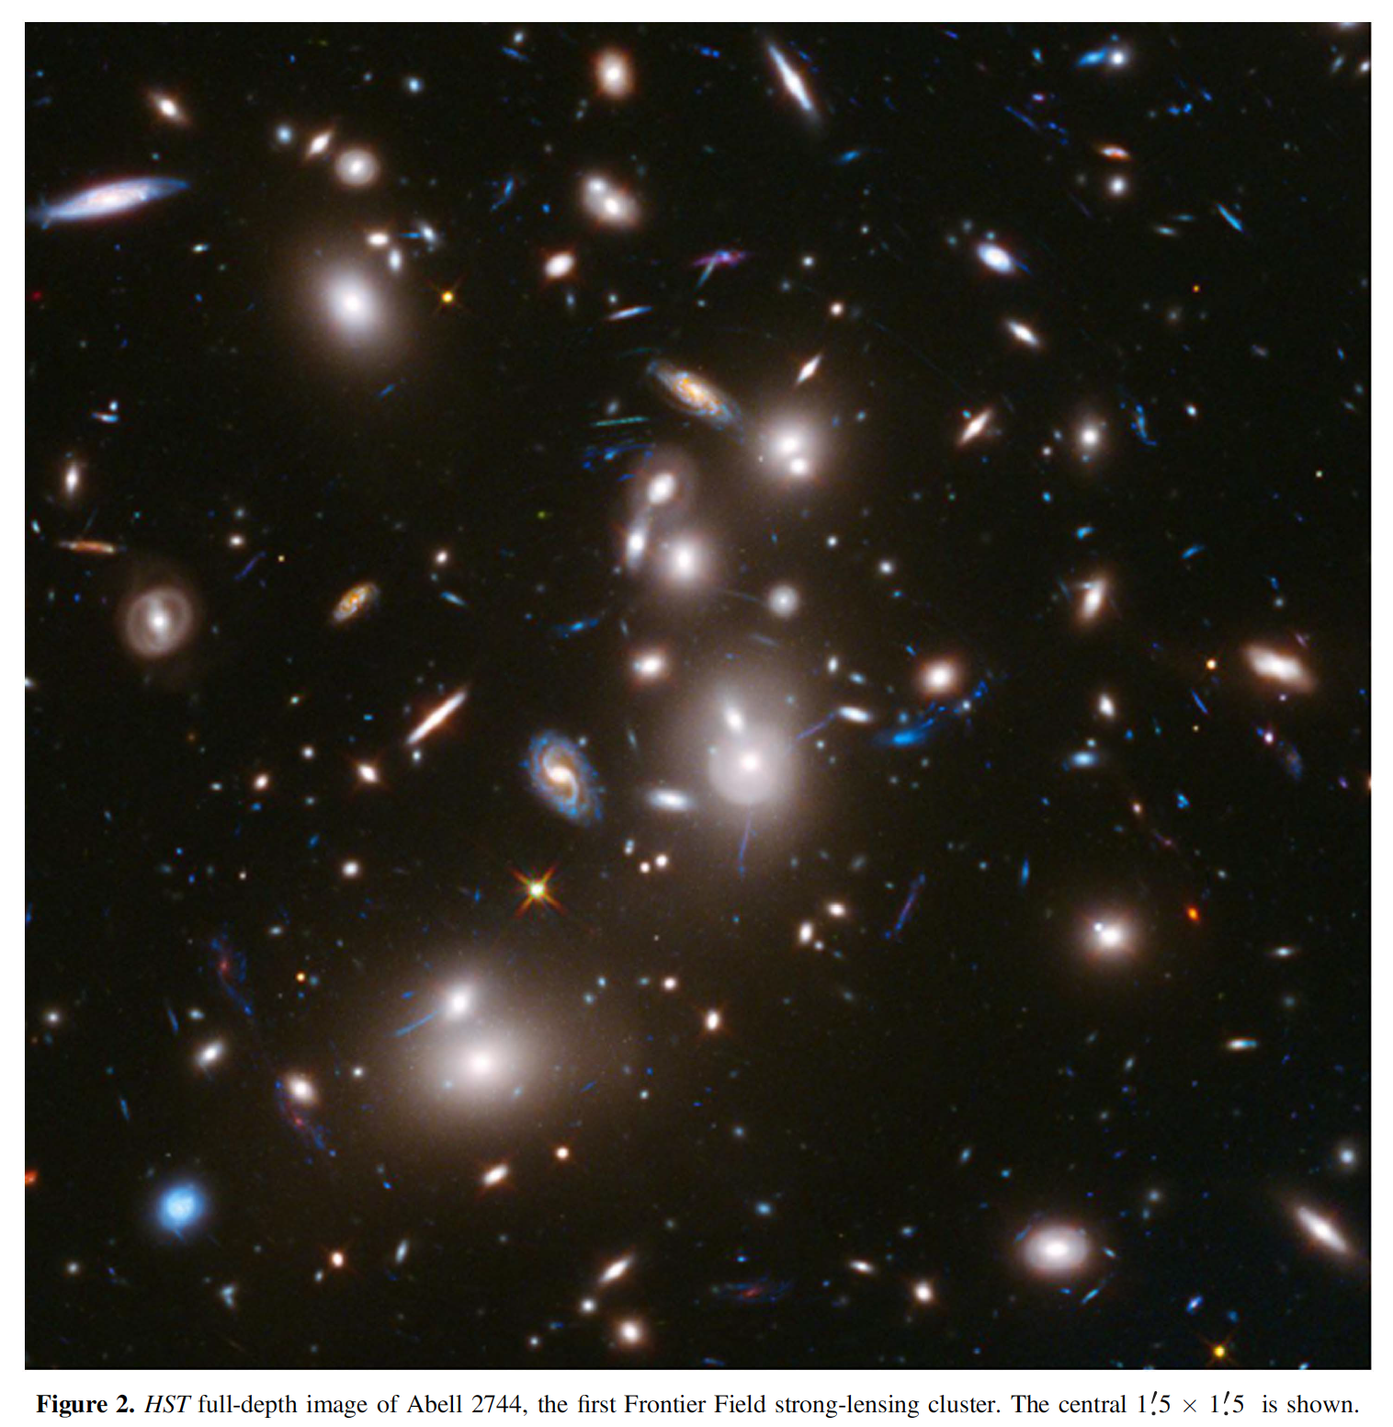
Lotz et al. 2017
SFMS
DATA
SEDs
MS
RESULTS
CONCLUSION
Notes:
Magnification models from 5 different teams.
Flux AND area increase by factor mu
GREEN is HST image
BLUE is mass
RED is magnification up to 100x

Slide 12
The Data
ASTRODEEP catalogue
4 fields, 29373 objects
Require H band < 27.5
RELFLAG = 1
SFMS
DATA
SEDs
MS
RESULTS
CONCLUSION
Notes:
Multiwavelength catalogues for 4 clusters:
Abel2744
MACS0416
MACS0717
MACS1149
Photometry - Merlin et al. 2016 and Di Criscienzo et al. 2017 (+z)
Ground based VLT Ks band is added to Hubble and Spitzer
3x optical, 4x NIR, 2x MWIR

Slide 13
BEAGLE – BayEsian Analysis of GaLaxy sEds
We have fluxes and errors from ASTRODEEP
Grid based SED fitting codes struggle with large parameter space and meaningful errors (from chi-squared etc)
BEAGLE uses Nested Sampling (multinest)
Can fit more parameters
Self-consistent modelling of the SED
Covarying posterior distributions for the model parameters
(including mass, SFR and redshift)
Chevallard & Charlot 2016
SFMS
DATA
SEDs
MS
RESULTS
CONCLUSION
Notes:
BayEsian Analysis of GaLaxy sEds
Chevallard & Charlot 2016
Nested Sampling
STAR FORMATION HISTORY
sfh_type delayed
tau fitted uniform range:[7.,10.5]
max_stellar_age fitted gaussian mean:8. sigma:2. range:[6.,10.]
mass fitted uniform range:[5.,12.]
redshift fitted uniform range:[0.,15.]
metallicity fitted uniform range:[-2.1,0.3]
DUST
tauV_eff fitted exponential range:[0.,2.]

Slide 14
Population of stars in HR with same age and metallicity, but different mass
Chabrier 2003
Latest version of Bruzual & Charlot 2003 models
SFMS
DATA
SEDs
MS
RESULTS
CONCLUSION
Notes:
BEAGLE – BayEsian Analysis of GaLaxy sEds
Simple stellar population
All formed same metallicity at same time, according to an IMF

Slide 15
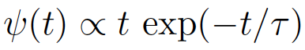
Charlot & Fall 2000
2 component model:
Diffuse ISM + stellar birth clouds
τ_{V} : V band optical depth
μ : fraction from diffuse ISM
PLUS
Gutkin et al. 2016 photo-ionization models
Nebular (line and continuum) emission is characterised by effective (galaxy wide) ionised gas parameters:
Z_{ISM}, U_{s} and ξ_{d}.
SFMS
DATA
SEDs
MS
RESULTS
CONCLUSION
Notes:
Delayed exponential allows rising SFHs (opposed to constant, or exponential declining)
Nebular emission is characterised by effective (galaxy wide) ionised gas parameters:
Zism = interstellar metallicity
Us = the typical ionisation parameter of a newly ionised HII region, characterises the ratio of ionising photon densities to gas densities at the edge of the stromgren sphere.
xi_d = dust to metal mass ratio, the ratio of metal in dust to the metal overall, so 0.5 means half of the metals are in dust grains. NOTE dust is basically 100% metal by mass.

Slide 16
PLUS IGM absorption (Inoue et al. 2014)
SFMS
DATA
SEDs
MS
RESULTS
CONCLUSION

Slide 17
SFMS
DATA
SEDs
MS
RESULTS
CONCLUSION

Slide 18
Subset Selection
Grey:
H band < 27.5
RELFLAG = 1
Chi-squared < 13 (99%, 10 filters, 6 params)
Red:
95% mass completeness (pre mag)
Tomczak upper mass cut (linear MS)
Remove poor IRAC z>4 (BLUE)
Visually inspect z>3.5
Must “match” for z<3.5
SFMS
DATA
SEDs
MS
RESULTS
CONCLUSION

Slide 19
SFMS
DATA
SEDs
MS
RESULTS
CONCLUSION
Notes:
95 % calculated from Jaguar catalogue.

Slide 20
SFMS
DATA
SEDs
MS
RESULTS
CONCLUSION
Notes:
We have our final subset.
Each point represents median from a 3D posterior

Slide 21
Bayesian hierarchical model of the MS
Based upon fits within redshift bins:
Slope constant with redshift
Scatter constant with redshift
Physically motivated Normalisation
SFMS
DATA
SEDs
MS
RESULTS
CONCLUSION

Slide 22
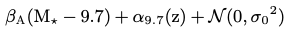
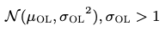
Bayesian hierarchical model of the MS
LEVEL 1:
Mass distribution modelled as weighted linear combination of 3 gaussians
Redshift distribution modelled as uniform
LEVEL 2:
Given Mass & Redshift, SFR is modelled as a linear combination of:
A linear MS with gaussian INTRINSIC scatter in SFR
An outlier distribution, NOT f(M, z), but z<4
LEVEL 3:
Given Mass, SFR & Redshift, the “measured” values will be perturbed by additional heteroskedastic and correlated uncertainties on the TRUE values
SFMS
DATA
SEDs
MS
RESULTS
CONCLUSION
Notes:
Uncertainties propagated onto MS, things like sigma clipping don’t allow this.
Quantifies possibility of on OR off MS

Slide 23
Modelling the Main Sequence
Kelly 2007 proposes a Gibbs sampler
Curtis-Lake et al. 2021 adapt this to take BEAGLE posteriors
RECAP: we have implemented an outlier model + redshift evolution
SFMS
DATA
SEDs
MS
RESULTS
CONCLUSION

Slide 24
Results
Slope and Normalisation agree with literature
Kurczynski also used del-exp SFH
Intrinsic Scatter ~0.25 dex
SFMS
DATA
SEDs
MS
RESULTS
CONCLUSION

Slide 25
Results
Agrees with literature
We have NOT measured sSFR and redshift, and “fitted a line”
We have modelled MS + outliers in mass, SFR and redshift
SFMS
DATA
SEDs
MS
RESULTS
CONCLUSION

Slide 26
Conclusions
We have probed MS to low mass (10⁷) and high redshift (z=6)
Agree with published results
First fully Bayesian self-consistent propagation of object uncertainties onto the MS, including:
explicitly modelling an outlier distribution
a physically motivated parameterisation with redshift
SFMS
DATA
SEDs
MS
RESULTS
CONCLUSION

Slide 27
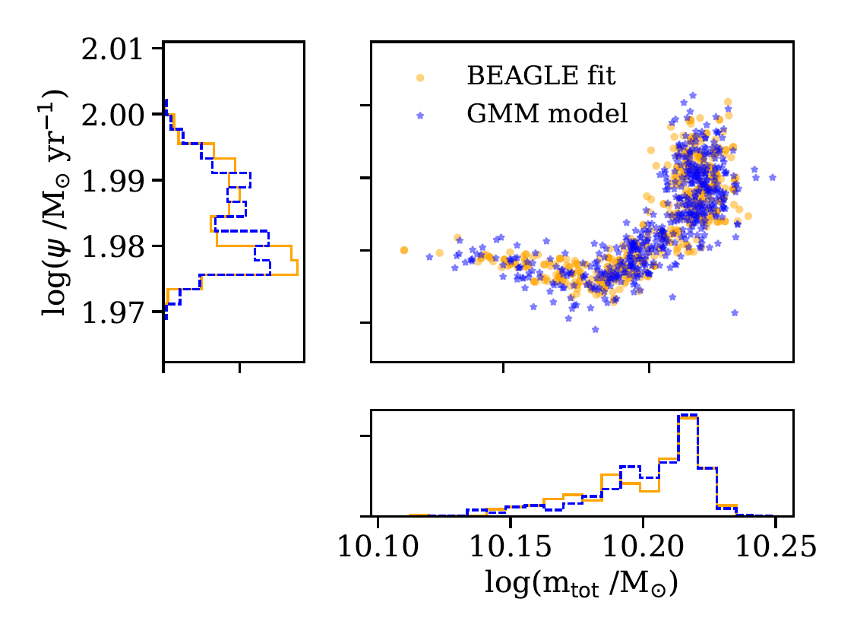
Adapting the Kelly model for BEAGLE
Instead of measured values of mass and SFR (plus errors),
We have the joint posterior distributions of the mass and SFR given photometric flux (plus errors)
Curtis-Lake et al. 2020
SFMS
DATA
SEDs
MS
RESULTS
CONCLUSION
Notes:
Emma has updated the Kelly Gibbs sampler:
Kelly model assumes measured data x, y with errors
We have joint posterior of mass and SFR GIVEN fluxes and errors
Emma then uses GMM to simplify the calculations

Slide 28
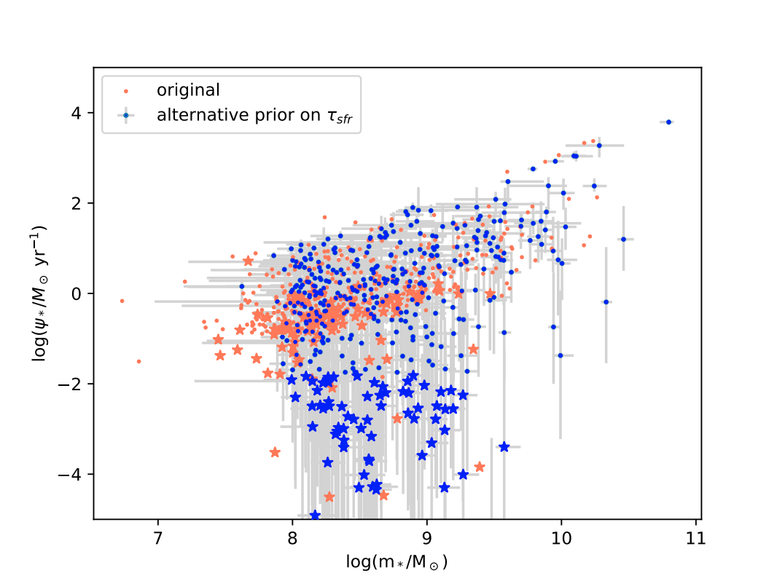
SFH
SFMS
DATA
SEDs
MS
RESULTS
CONCLUSION
Notes:
Done similar to other people, but with BEAGLE we can go deeper and change priors etc.
This gives scary result as shown.
We agree with everyone else because we’ve done what they did, BUT this shows it isn’t necessarily correct and our previous results can’t be fully trusted

Slide 29
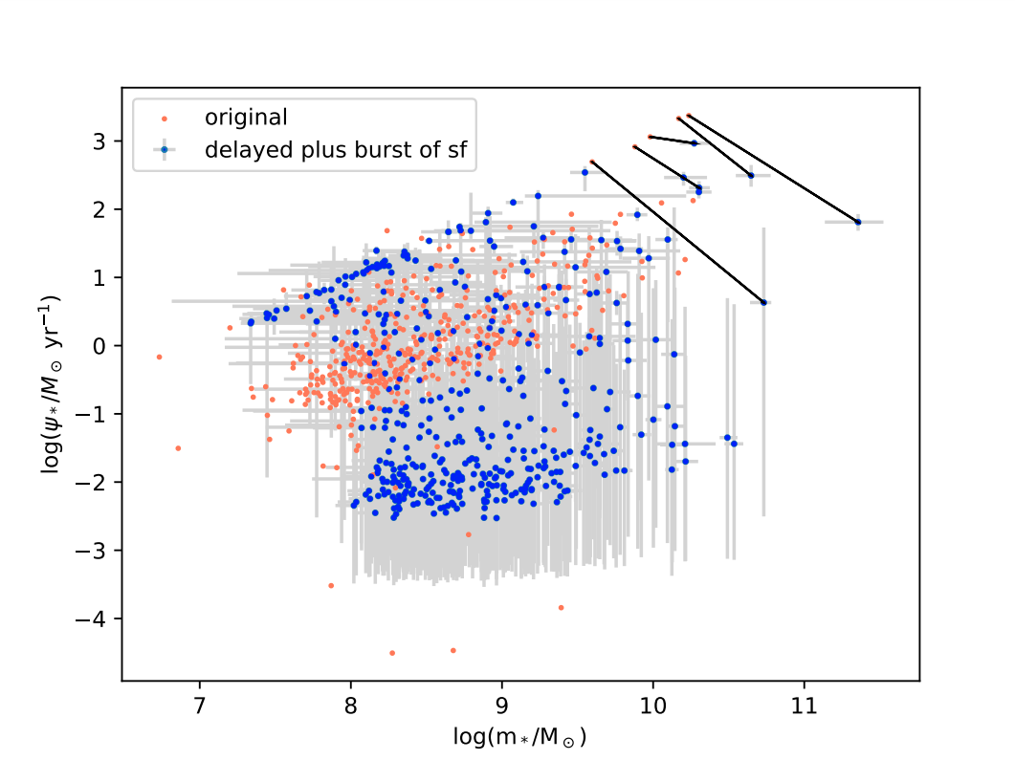
SFMS
DATA
SEDs
MS
RESULTS
CONCLUSION
Notes:
Postage stamps to show unlikely crazy starbursts

Slide 30
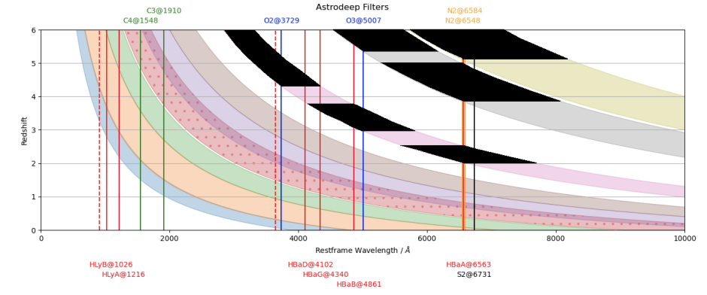
SFMS
DATA
SEDs
MS
RESULTS
CONCLUSION

